Slide 1
Smart Systems
Tussentijdse presentatie Poembak Delco

Slide 2
opdracht

Slide 3

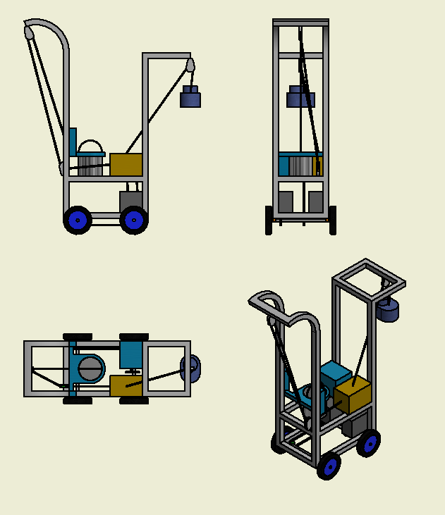
Overzetten van water
Autonomous design
Open bucket
10L in 5 minuten

Slide 4
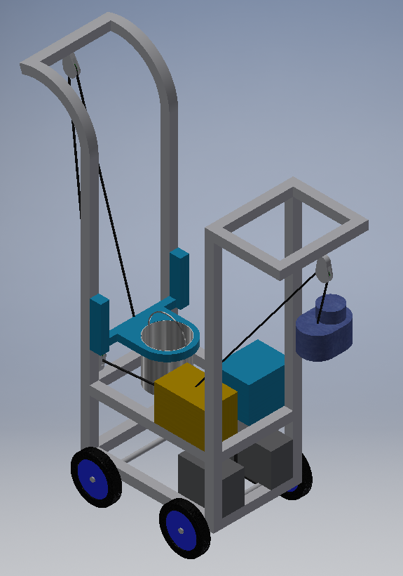
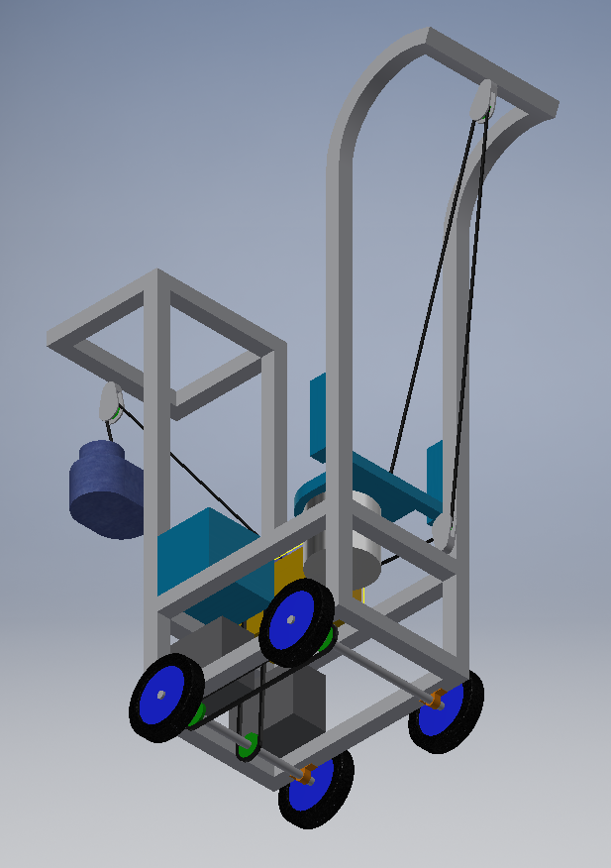
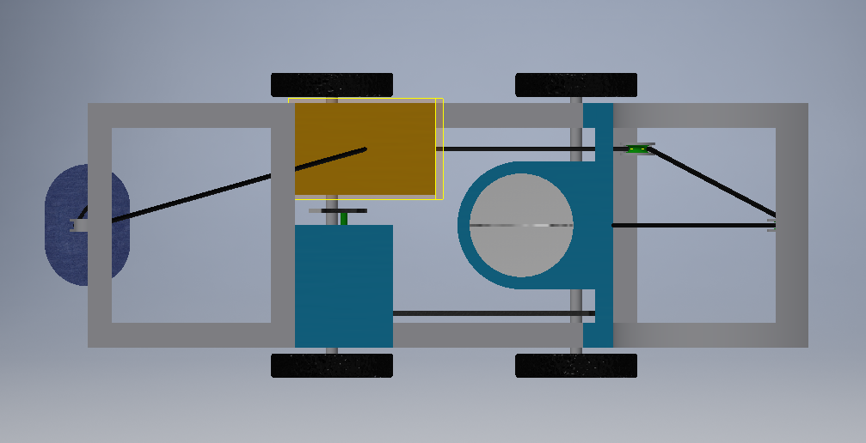
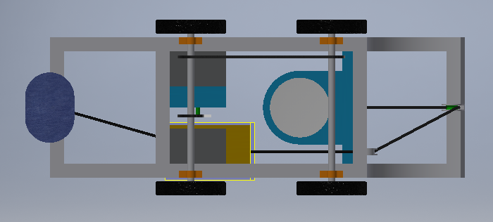
Designs

Slide 5
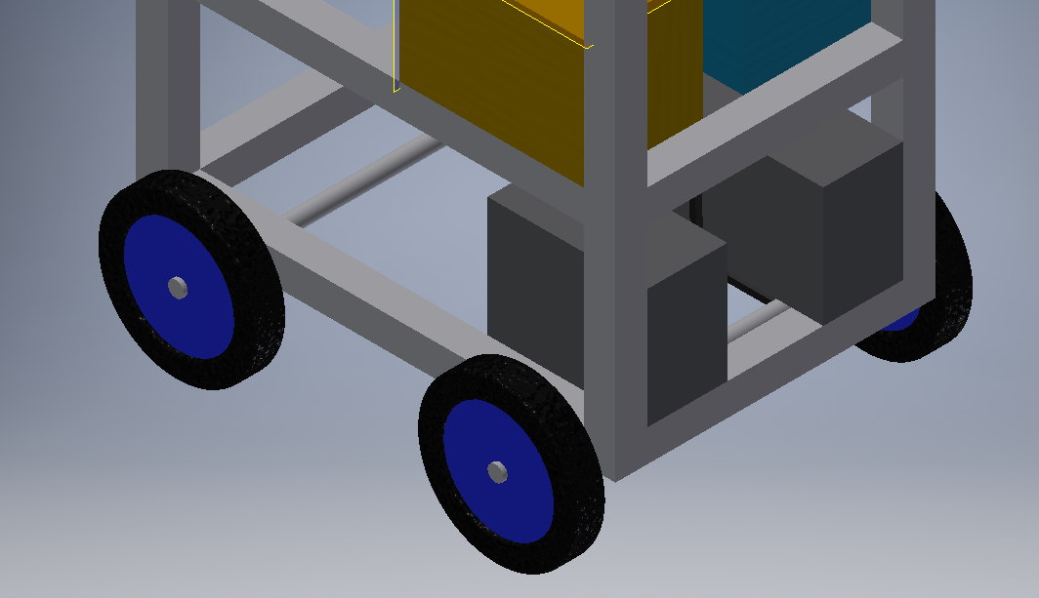
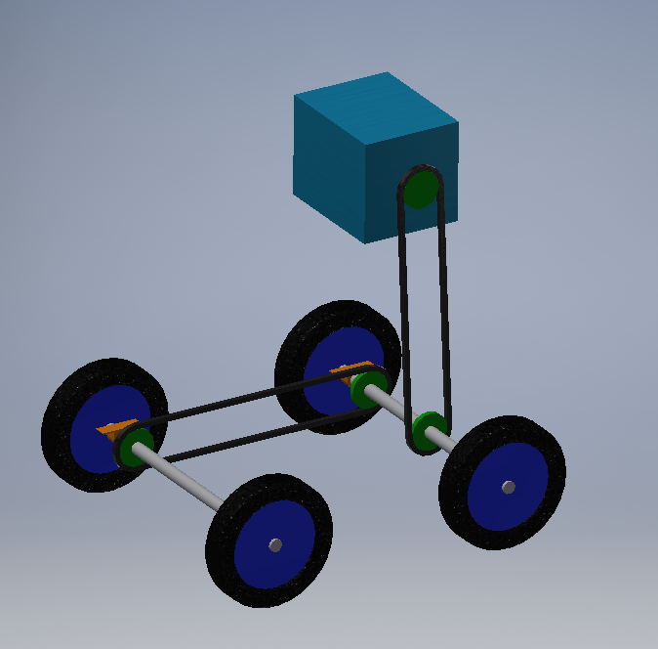
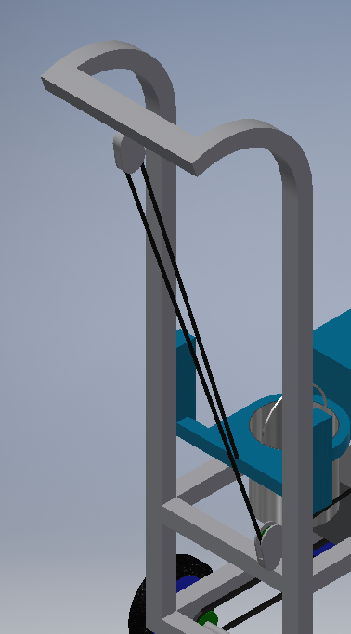
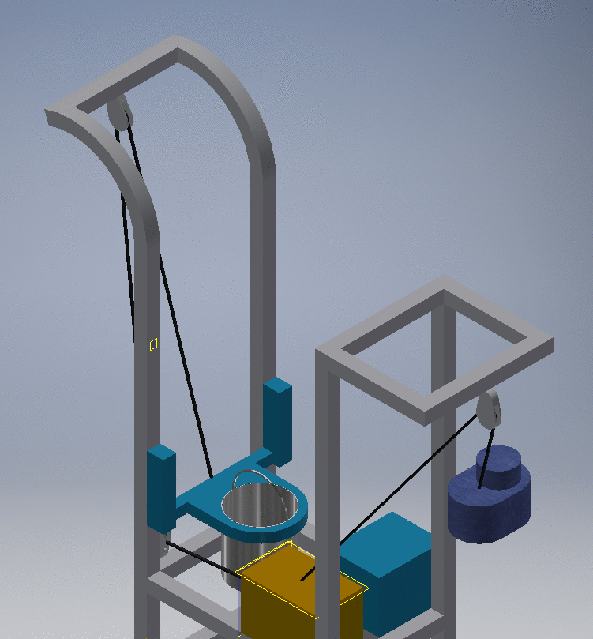
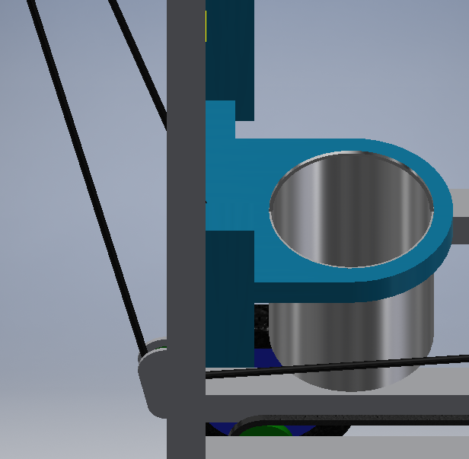
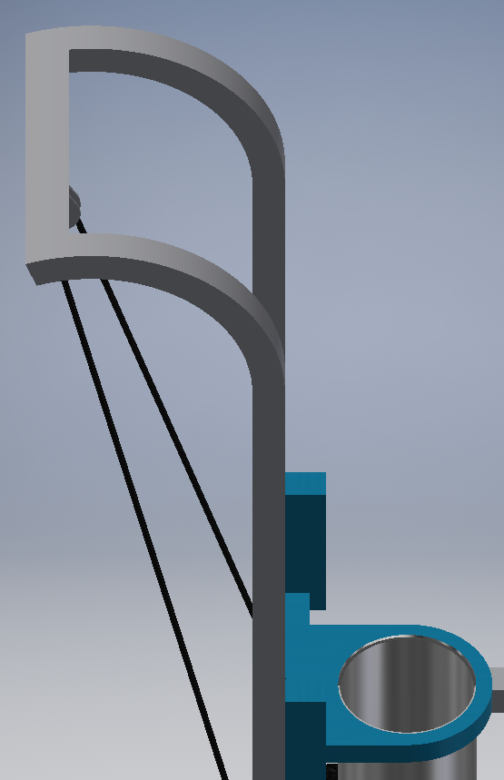

Slide 6
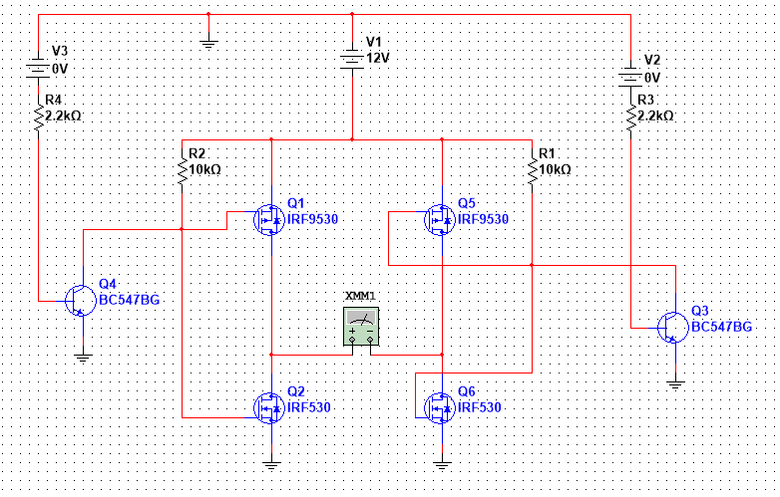
Motorcontroller

Slide 7
Meet the team

Slide 8
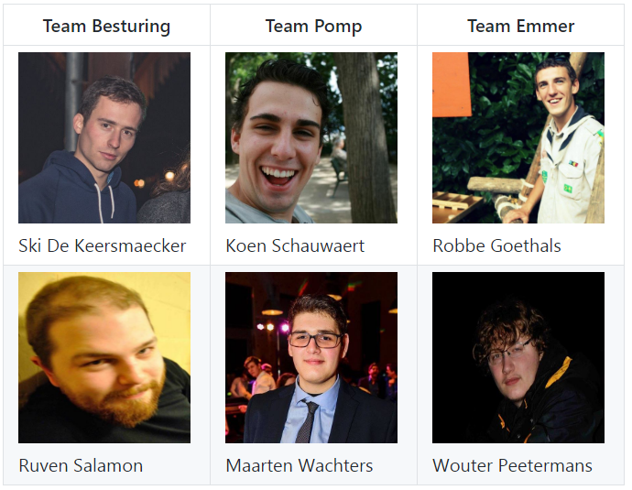
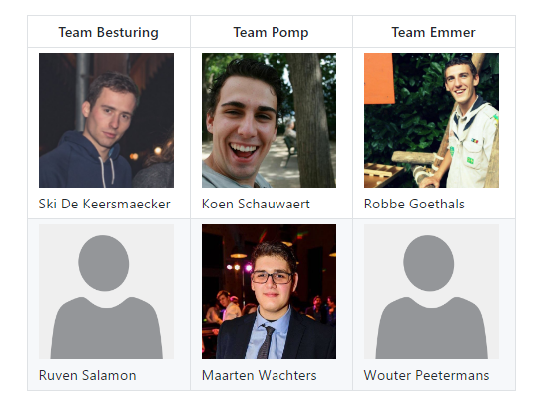

Slide 9
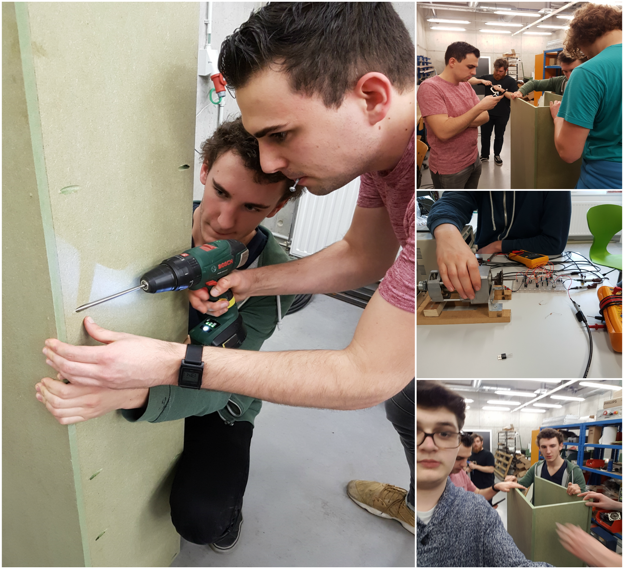

Slide 10
Progress
What have we been up to?

Slide 11
Checklist
Sponsoring CCM
Maken motorcontroller
Frame
Sturing motor
Sensoren inlezen
Doorsturen van data

Slide 12
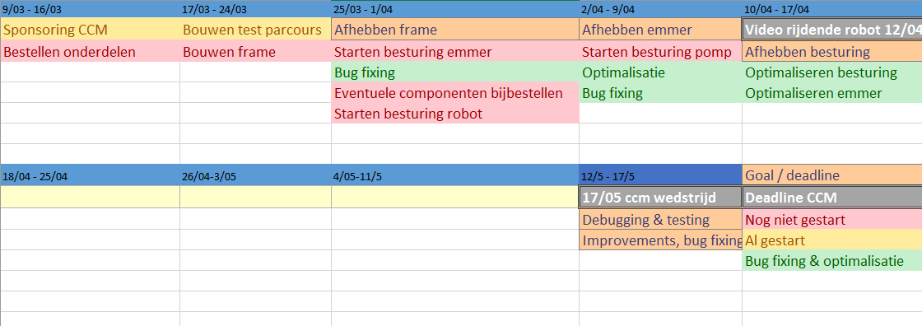
Planning

Slide 13
Documentatie

Slide 14
Links
Github: https://github.com/ccmteamap/robot
Wiki: https://github.com/ccmteamap/robot/wiki
Info CCM: http://www.ccm.nl/nl/trofee/
Issues & sprints: https://github.com/ccmteamap/robot/issues
Online roadmap: https://app.ganttpro.com/#!/app/home

